Slide 1
Interactive Voice for Cooking Recipes
By Andrew Sullivan, Brock Buczkowski, Sam Munro, and Zhen Yang

Slide 2
Background
Currently, online recipes are sequestered in individual company databases, almost like silos
Existing technologies allow voice playback and interaction for users’ recipes, at least the ones that are compatible with the existing technology. These mostly are implemented in-app
There is a hole in the market for a connection between separated voice interactions and user controlled CRUD operations regarding cooking recipes
Amazon Alexa
Google Home
Current product name: AllAboutFood

Slide 3
Project Overview
Architecture Walkthrough
Example Data Flow
Flutter App
Lambda Functions
Dynamo DB
Amazon Alexa
Amazon S3
Web Hosting
Demo
Lessons Learned

Slide 4
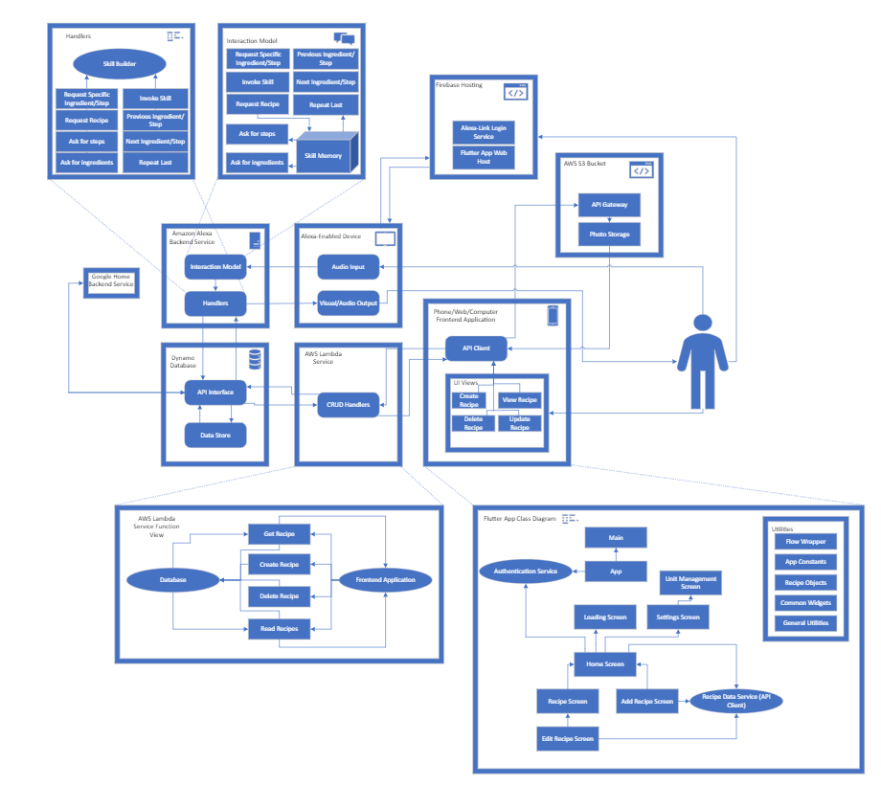

Slide 5
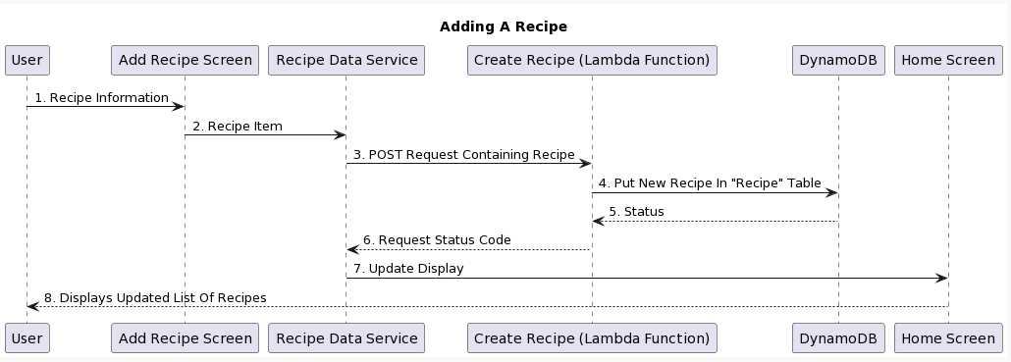
Architecture - Example Data Flow

Slide 6
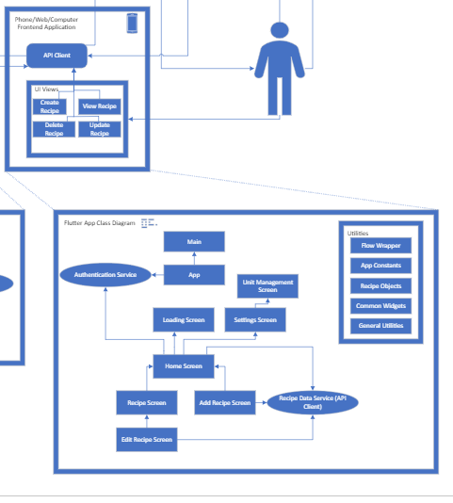
Architecture - Flutter App
Makes up half of the user’s entry to the system
Allows all CRUD operations regarding recipes
Frontend account management
Creation
Password resets
Change display name
Extra features
Recipe downloads
Recipe forking
Login-based access
Communicates with both AWS Lambda and Firebase Authentication
Image upload
Local device storage

Slide 7
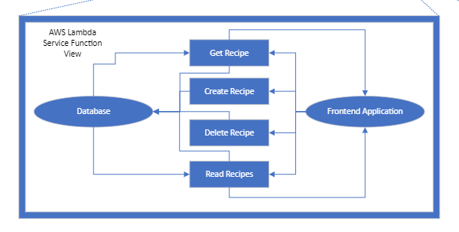
Architecture - AWS Lambda
Serves as the link between the database and the Flutter App
Decodes JWT tokens sent from the client
Checks users against Firebase table
Verifies Signatures
Primary justification: abstract relatively complex Dynamo DB calls from the client

Slide 8
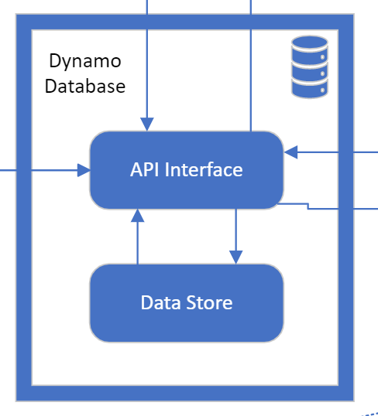
Architecture - Dynamo DB
Datastore for all recipes associated with the system
NoSQL format allows quick testing with new attributes, without requiring massive table changes
Part of the AWS suite, allowing easy management

Slide 9
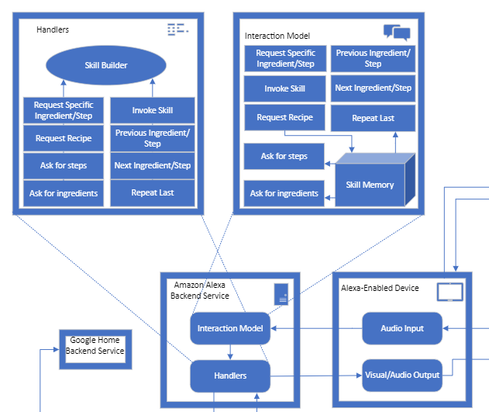
Architecture - Amazon Alexa
Custom Amazon Alexa Skill
Provides full recipe navigation and playback
If using on a supported device, photos and recipe details can be displayed on the device in parallel with Alexa voice responses

Slide 10
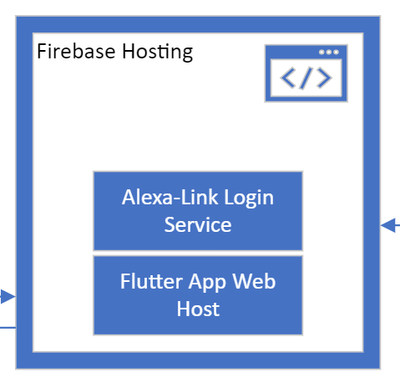
Architecture - Firebase Hosting
Dual use hosting service provided by Firebase
Alexa - App linker
Necessary step that allows Alexa to access a user’s private recipes in the database
Links Amazon account to AllAboutFood account
Flutter App Web App
Hosts the web version of our Flutter App on the open web so anyone can access it
Sideloading the Android App is also an option for publishing

Slide 11
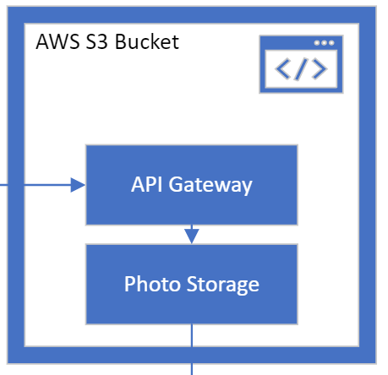
Architecture - Amazon S3
To get around CORS restrictions, we needed to host our own images on the internet so that the web version of the client could access them
Mobile apps do not have this restriction
Our solution for this is Amazon S3
Grants CORS use to our web app only
Images are uploaded via the mobile version of the frontend

Slide 12
Future Work
Google Home implementation
Create a Google Home Action that performs the same operations as the Alexa Skill
New market of users
Research ways of scanning recipes from other sources to the database
We have started preliminary research here, but it may be out of scope
One possibility is docx -> xml -> database
Documentation, documentation, documentation
App Features
External Logins
Google - works locally but requires registration with Google to work in production
Facebook - requires registration with Facebook
Publishing to App and Play Stores

Slide 13
Demo

Slide 14
Lessons Learned

Slide 15
Lessons Learned - Project
Use tools and frameworks you are familiar with, if possible
Rose/internships have prepared you for this, don’t feel as if you need to reinvent the wheel
Using familiar tools can expedite the initial development process
Design the system to be flexible with client requests
Some items in AllAboutFood had to be “hacked-in” since they were not originally considered in the design
Other areas we did well with - such as making it easy to add new recipe attributes
If dealing with an internet system, learning configuration is your friend!
The internet and associated tools have lots of quirky rules
Knowing these and how to configure your systems to abide by them will save a lot of time

Slide 16
Lessons Learned - Client
Attempt to establish MVP early
Allows client to test the project and give feedback ASAP
We suffered from lack of meaningful feedback for the first 2 quarters
Clients will often not have all of the answers
You must act as a designer to help them develop their ideas
Get feedback on your designs
Sometimes, your ideas will be really popular (EX: Recipe forking)
Be very clear about reasonable expectations and what you will be able to achieve
Clients will often be unaware how difficult it is to implement their ideas.
Let them know when they are asking for something unreasonable or impossible.

